Slide 1
47
Discrete Mathematics
Algorithms for Integer Operations

Slide 2









Slide 3














Slide 4






Slide 5


















Slide 6


Slide 7










Slide 8










Slide 9
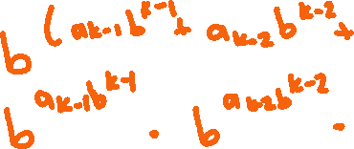













Slide 10
















Slide 11
Up Next…
Prime Numbers and Their Properties

